Slide 1
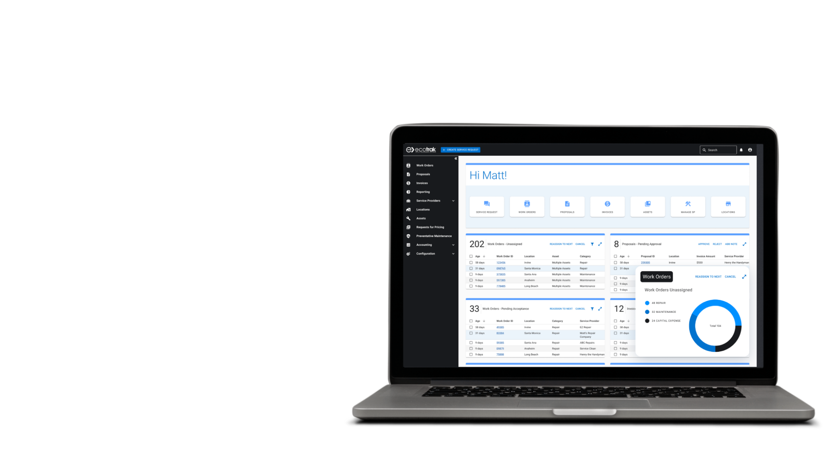
Ecotrak & Coupa Service Provider Training

Slide 2
Why Ecotrak
How It Works
How to Sign Up
Demo
Q&A
Agenda

Slide 3
Why Ecotrak
Saves Operations Time
Reduces unnecessary facilities spend
Monitor Work Orders
Service history and cost
Already being used in 6 Flynn Brands
Digital receiving of Work Orders
Asset & Problem data in Work Order
Work Order tracking
Access to other Flynn restaurants

Slide 4
How It Works
Flynn User creates a Work Order in Ecotrak
Service Provider accepts WO
If needed Service Provider submits a Proposal through Ecotrak
Once work is Completed, Service Provider marks WO as Complete in Ecotrak
Service Provider fills out the “Add Invoice” popup in Ecotrak & a PO is automatically created in Coupa
Supplier invoices Flynn by logging into Coupa directly or by using the link provided in Ecotrak

Slide 5
How to Sign Up
Service providers need to have an Ecotrak account and be linked to the Coupa Suppler Portal (CSP)
Accept Ecotrak invitation in email
Link to CSP from invitation in email
Any issues email ecotrak@flynnrg.com (Ecotrak) or supplierenablement@flynnrg.com (CSP)

Slide 6
Let’s Take a Look

Slide 10
Resources
Coupa Supplier Portal Training Resources can be found here.
Ecotrak
support@ecotrak.com
Flynn
Coupa Supplier Portal Setup - supplierenablement@flynnrg.com
Invoice Questions - acctspayable@flynnrg.com
Ecotrak Site Admin - ecotrak@flynnrg.com

Slide 11
Thank You!

